Slide 1

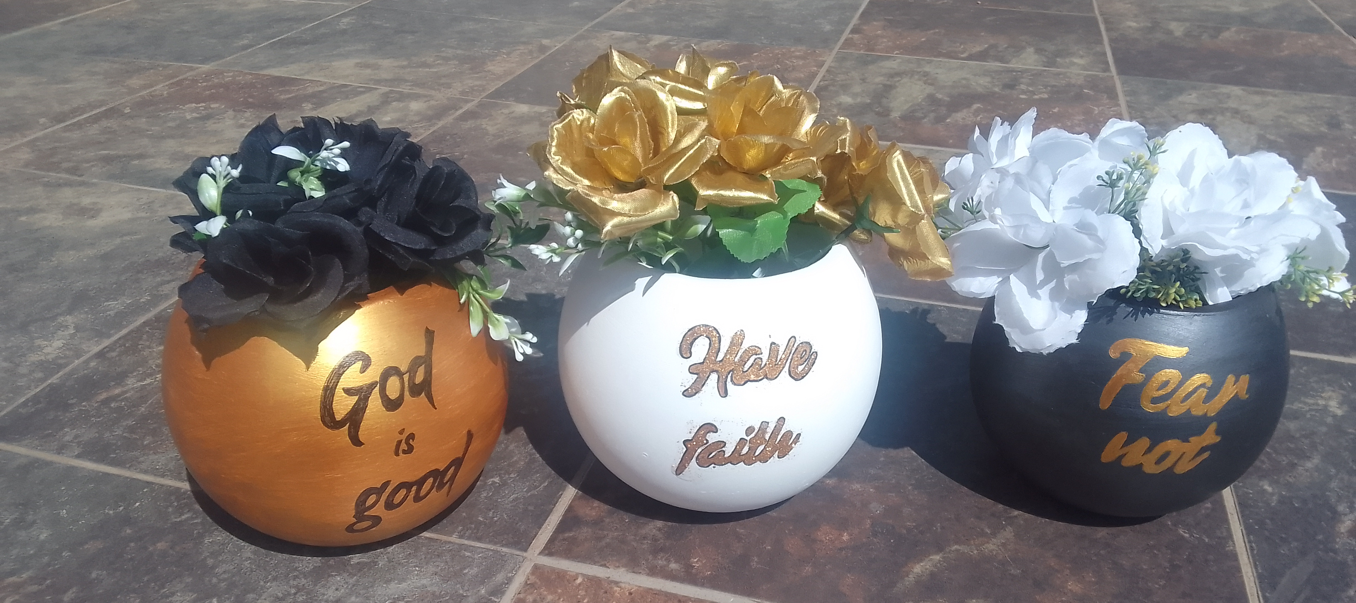






Home
About
Gallery
Custom
Shop
Contact
Custom Creations for Every Occasion
Brows Gallery
Order Custom Piece
At Clay Station 7, we bring your creative visions to life with handcrafted decorative cement art. Each piece is custom-made, ensuring that your special occasions are adorned with unique, personalized touches.

Slide 2
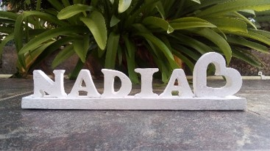
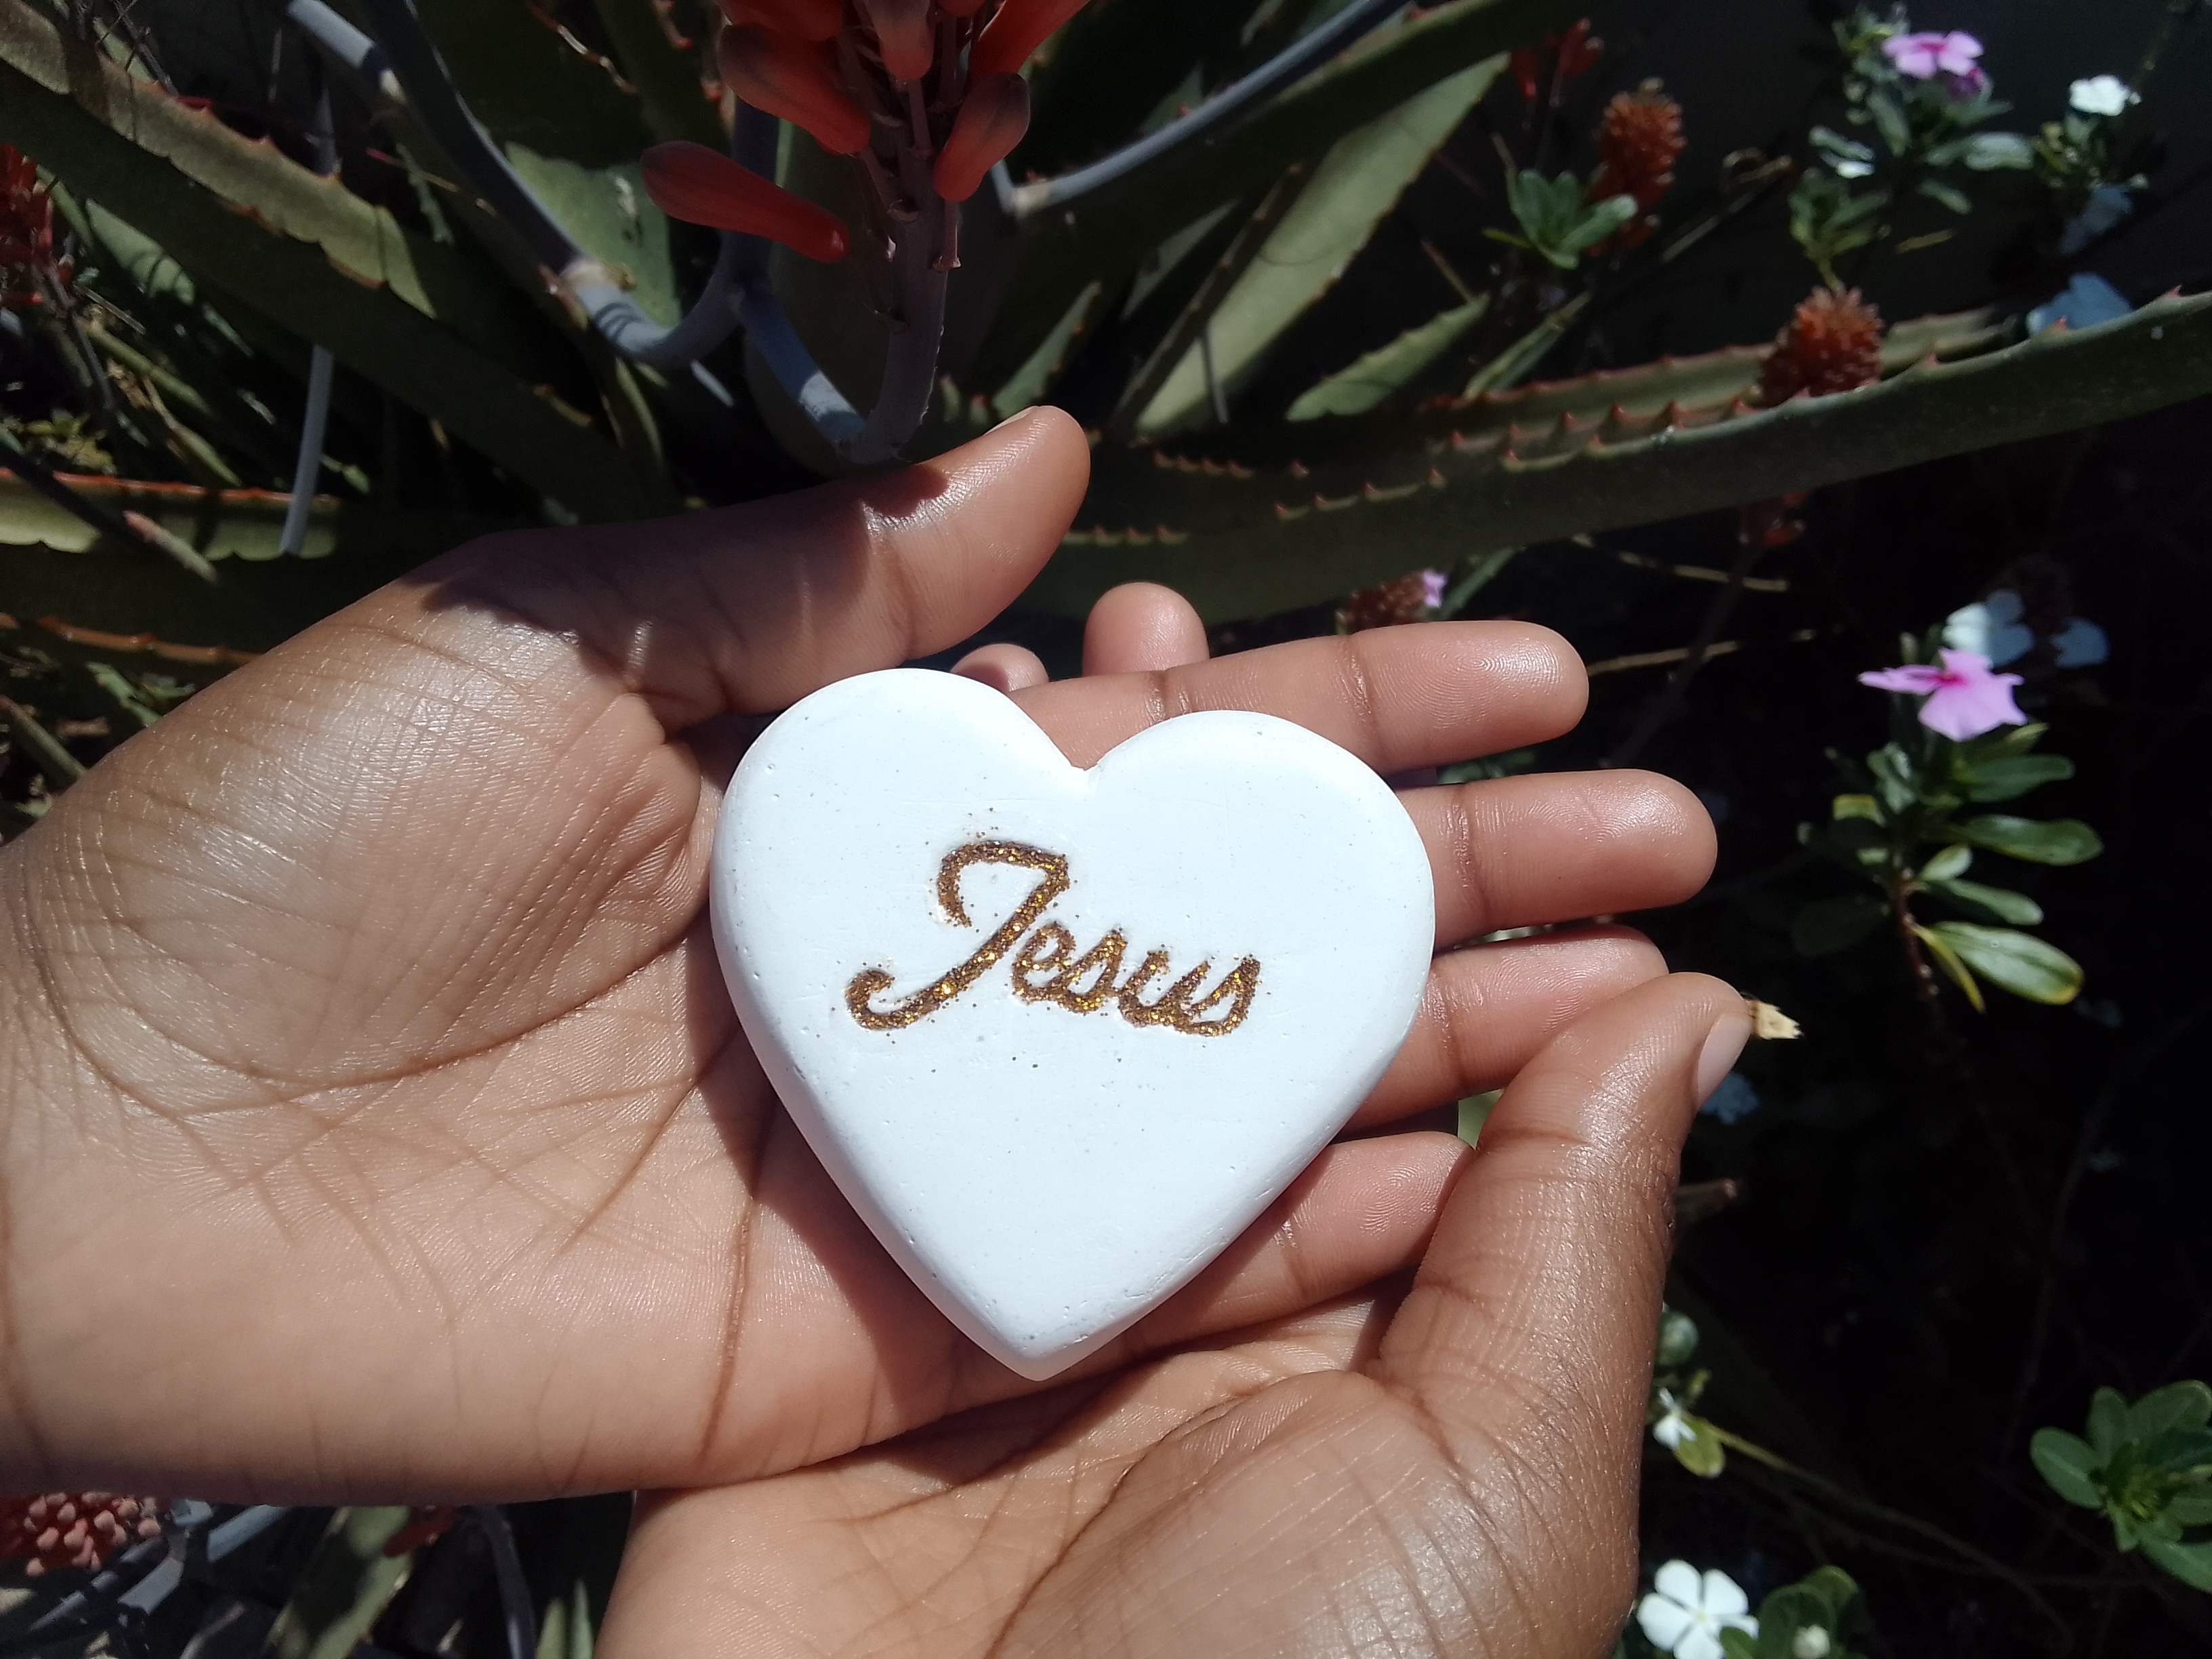
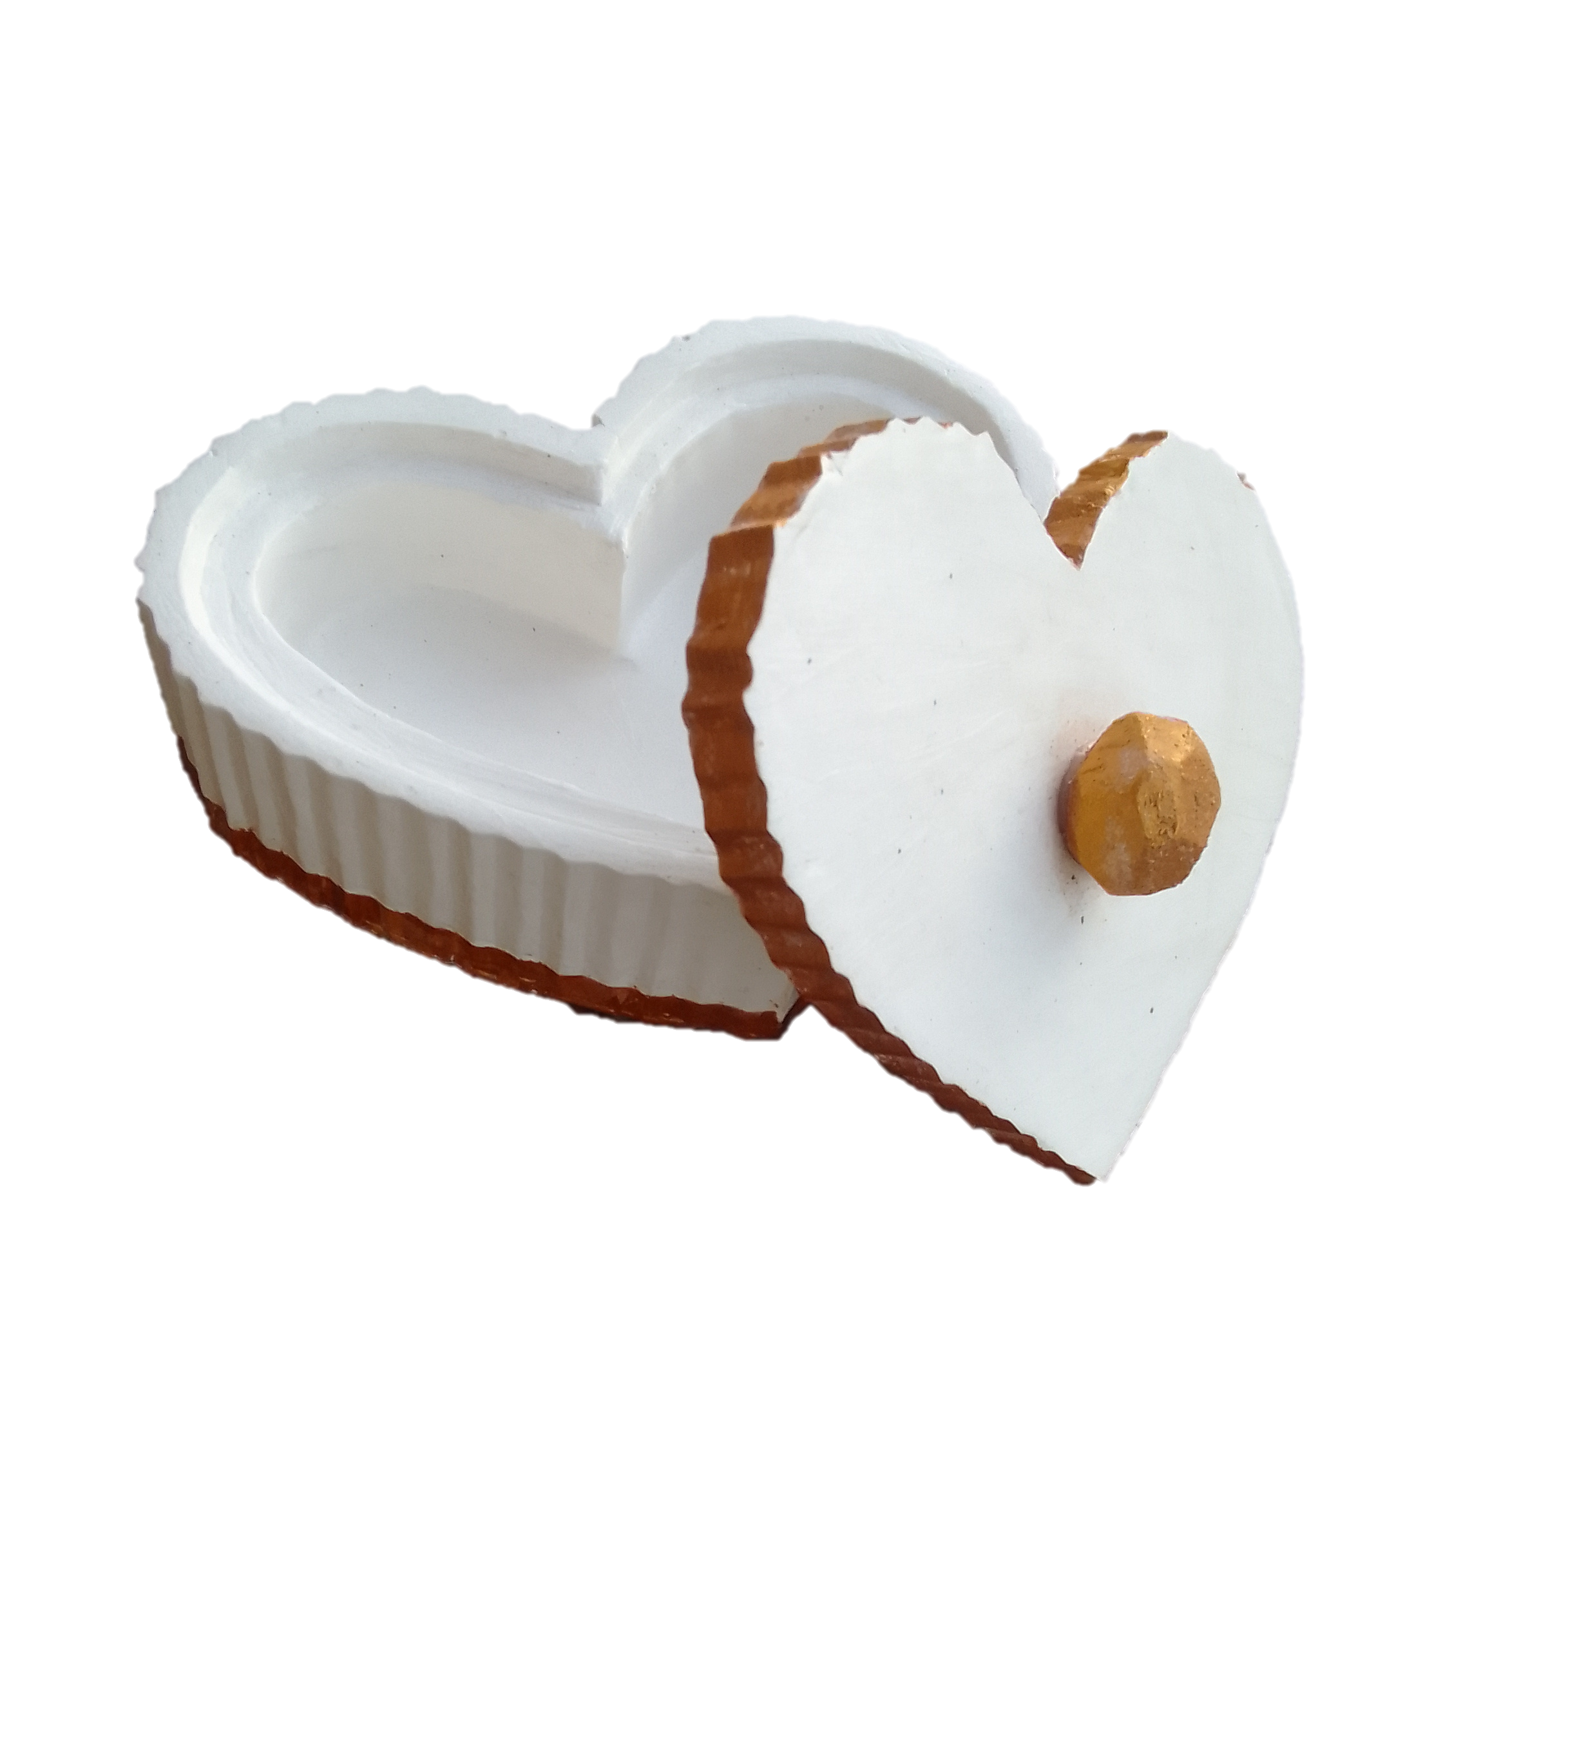
Customer Testimonials
My desk has never looked more beautiful with my custom name stand by ClayStation7
~ Nadia Pieters
This cement art reminds me that Jesus is my firm foundation.
~ Ebby
I really appreciate the ClayStation7 team for making this beautiful and unique jewelry
~ Cindy Dongua
Address: "123 Art Lane, Creative City, 56789 © 2024 Clay Station 7. All rights reserved.

Slide 3
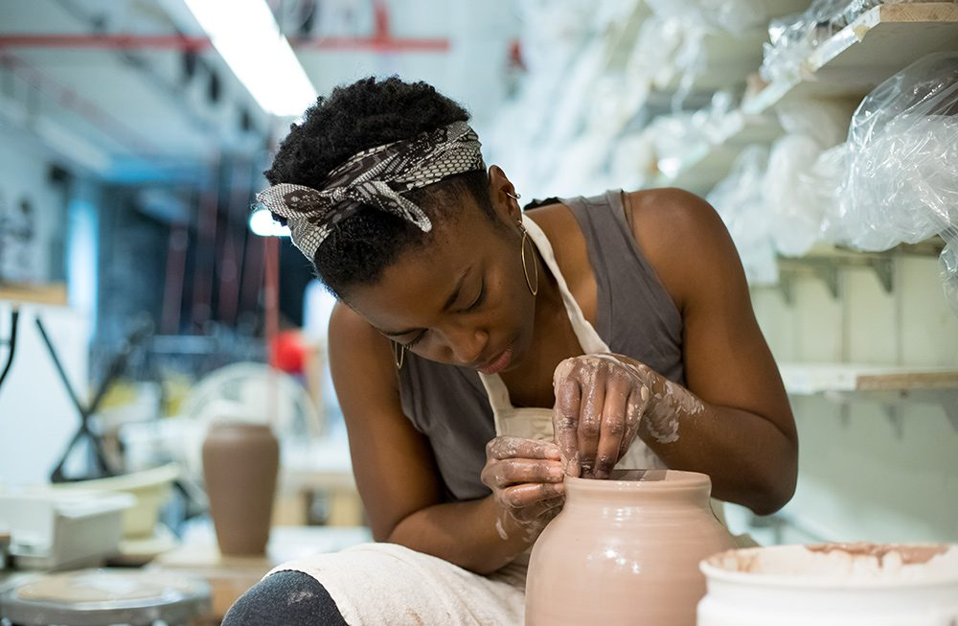
Home
About
Gallery
Custom
Shop
Contact
Our Story
Clay Station 7 was founded in 2022 with a passion for art and craftsmanship. Our journey began with a simple idea – to turn cement, a basic construction material, into something extraordinary. Today, we continue to push the boundaries of creativity, delivering custom art pieces that capture the essence of every occasion. Clay Station 7 is a proud family-owned business, and our core values are excellence, integrity and passion
The creative Process
Step 1: Conceptualization
We start by understanding your vision. Whether it's a custom order or a new collection, we work closely with you to conceptualize the design, ensuring it aligns with your style and preferences.
Step 2: Crafting
Our artisans then bring the design to life, carefully shaping and molding the cement to create intricate patterns and forms. This stage requires patience, skill, and an eye for detail.
Step 3: Finishing Touches
Finally, we add the finishing touches, including painting, polishing, and sealing. This ensures that each piece not only looks stunning but is also durable and long-lasting.

Slide 4

Meet the team
Alzira Dongua
Founder and Artist
Ebenezer Dongua
Visual artist
Alzira is the creative force behind Clay Station 7. With a background in fine arts and a passion for transforming raw materials into stunning cement art, Alzira founded the business in 2020. Her visionary designs and hands-on approach have turned Clay Station 7 into a pioneer in handcrafted cement art, known for blending industrial materials with elegant, personalized pieces.
Eben is the artistic mind behind the stunning visual presentation of Clay Station 7’s work. With a degree in graphic design and a passion for aesthetics, she is responsible for curating product photography, website visuals, and promotional materials that capture the unique beauty of each cement piece.
David Dongua
Logistics Manager
Augusta Dongua Financial Manager
David ensures the smooth operation of Clay Station 7’s supply chain and delivery services. With over 10 years of experience in logistics, he coordinates everything from sourcing eco-friendly cement materials to managing shipping timelines for custom orders. His organizational skills ensure that every piece arrives safely and on time.
Augusta handles the financial operations of Clay Station 7, including budgeting, invoicing, and financial planning. Her expertise in small business finance ensures that Clay Station 7 remains profitable while offering competitive pricing to clients. Augusta’s strategic approach has helped grow the business sustainably.
Address: "123 Art Lane, Creative City, 56789 © 2024 Clay Station 7. All rights reserved.

Slide 5
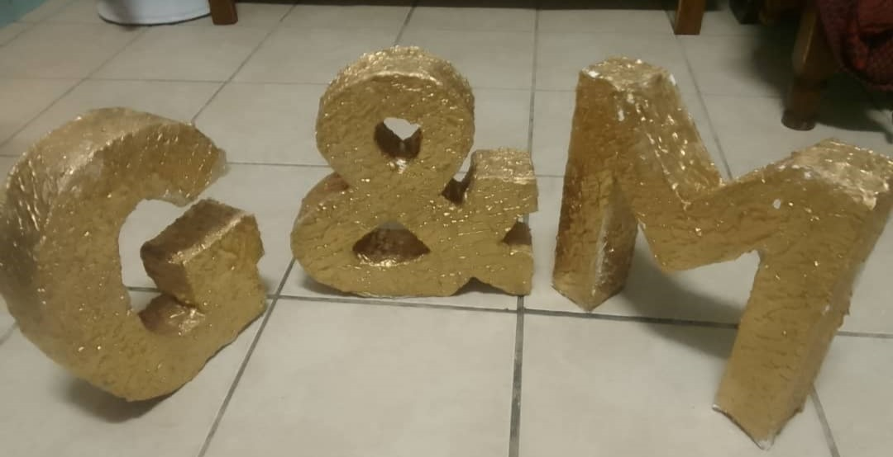
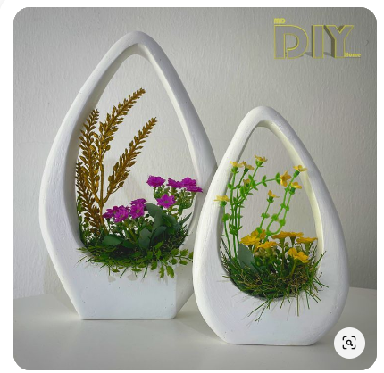
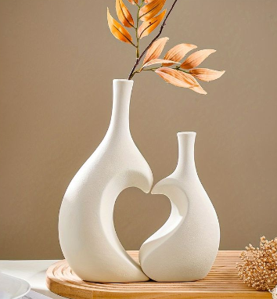
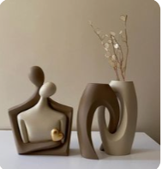
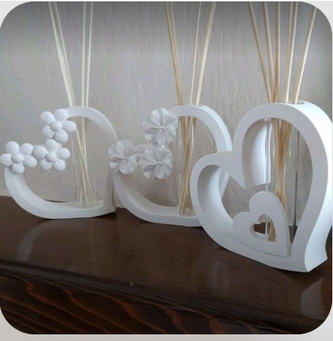
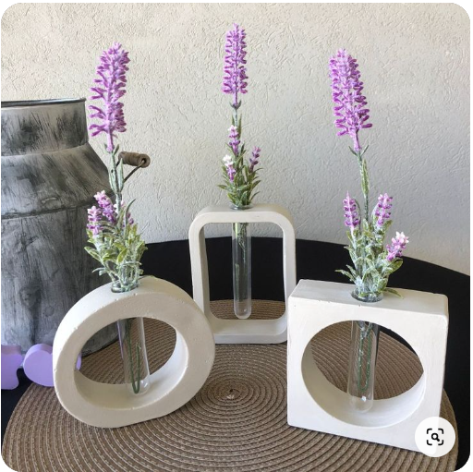
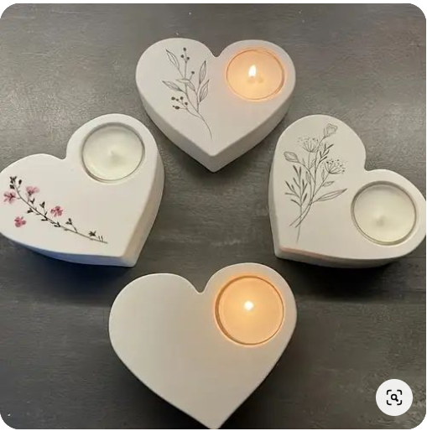
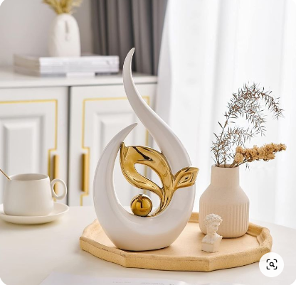
gallery

Slide 6
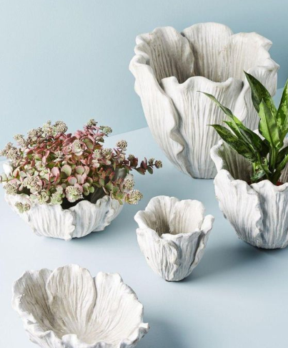
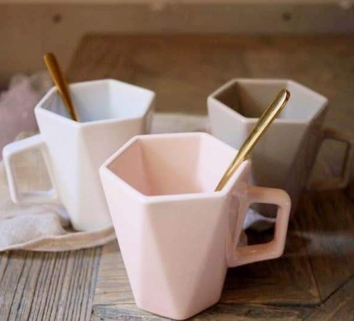
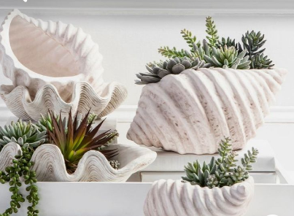

Slide 7
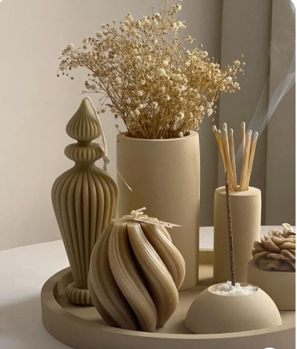
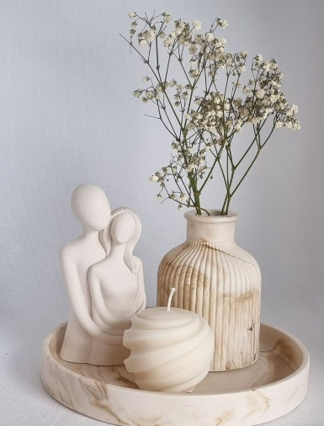
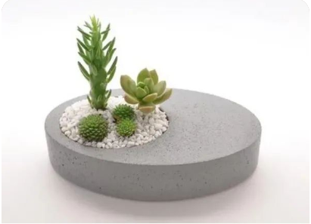

Slide 8
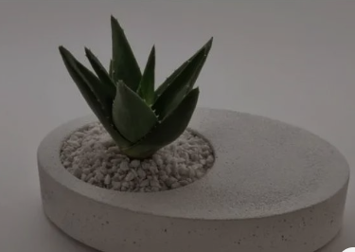
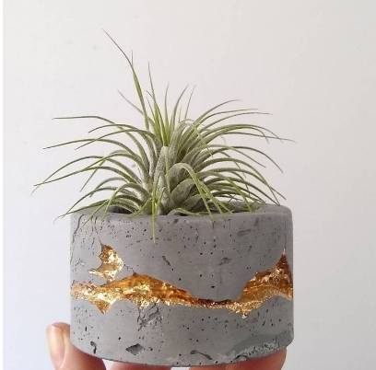

Slide 9
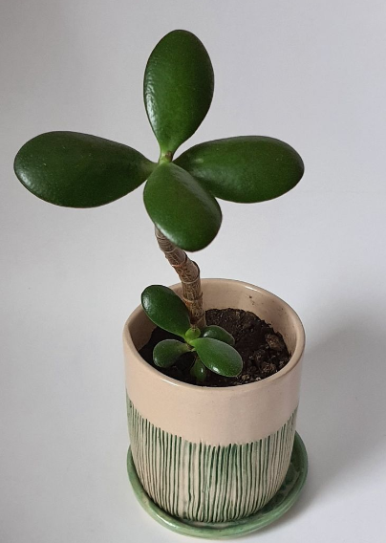
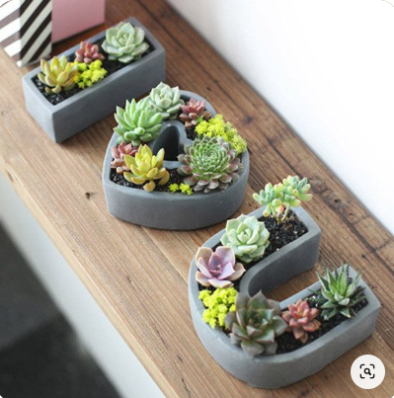
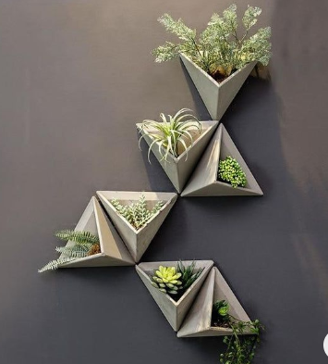

Slide 10
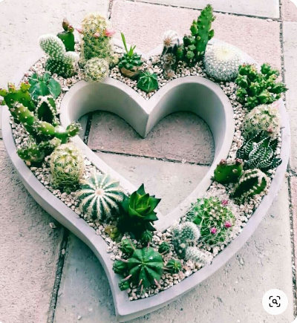
Clay Station 7

Slide 11
Home
About
Gallery
Custom
Shop
Contact
Clay Station 7
Address: "123 Art Lane, Creative City, 56789 © 2024 Clay Station 7. All rights reserved.

Slide 12
Clay Station 7

Slide 14
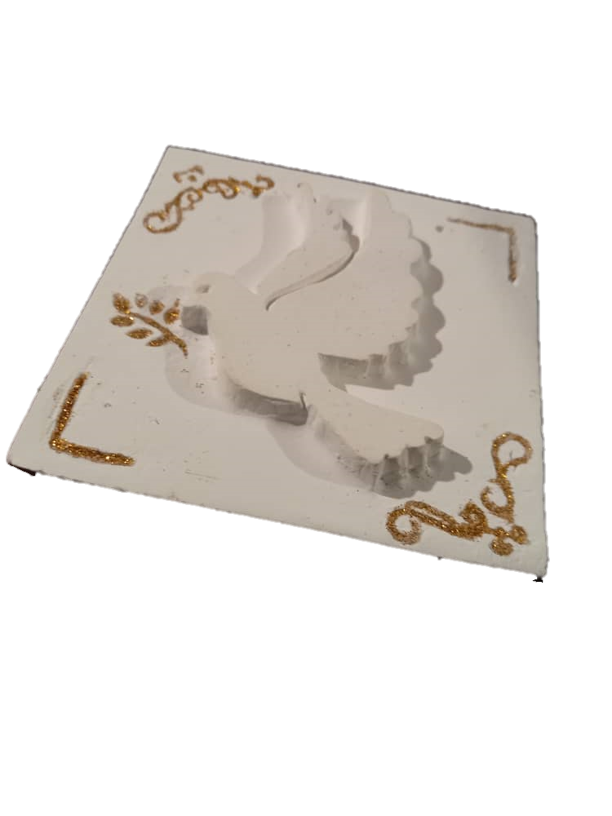
Home deco

Slide 15
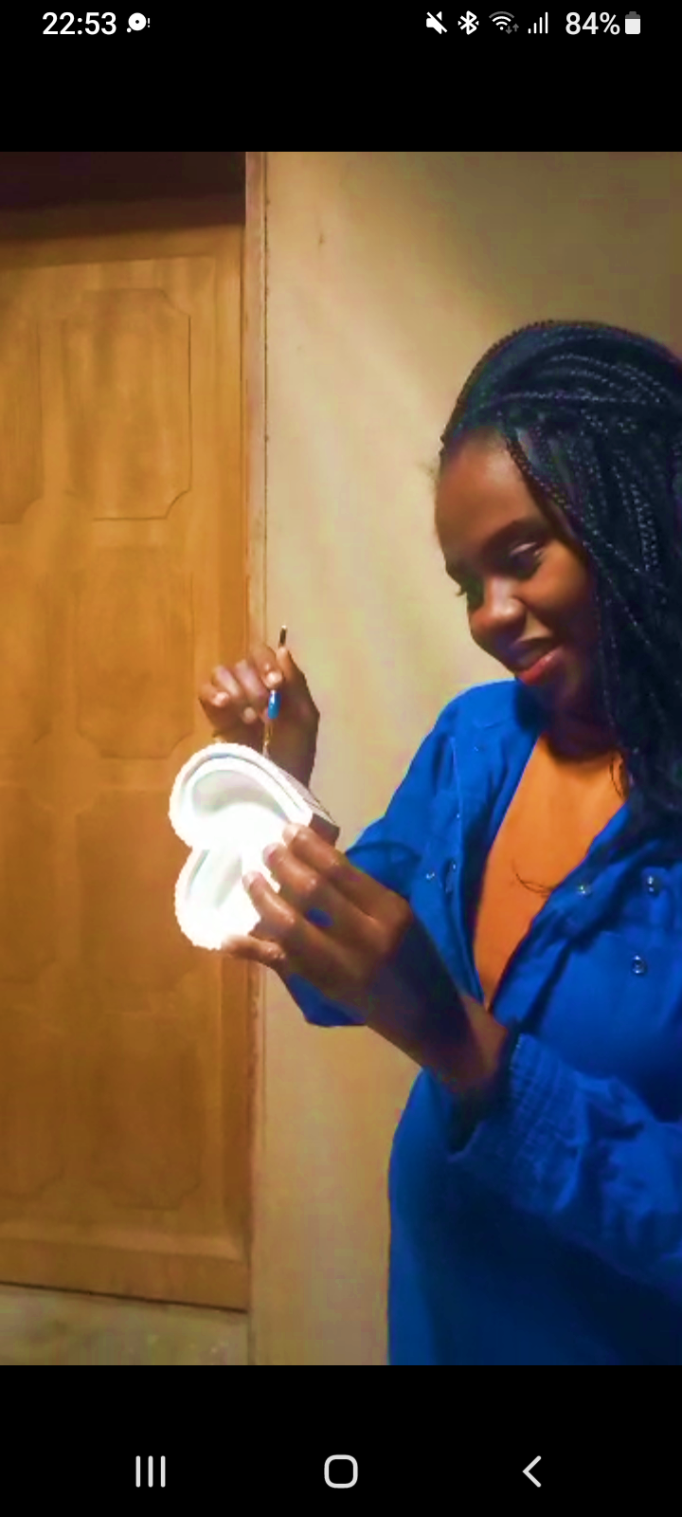

Slide 17




Slide 18



Slide 20
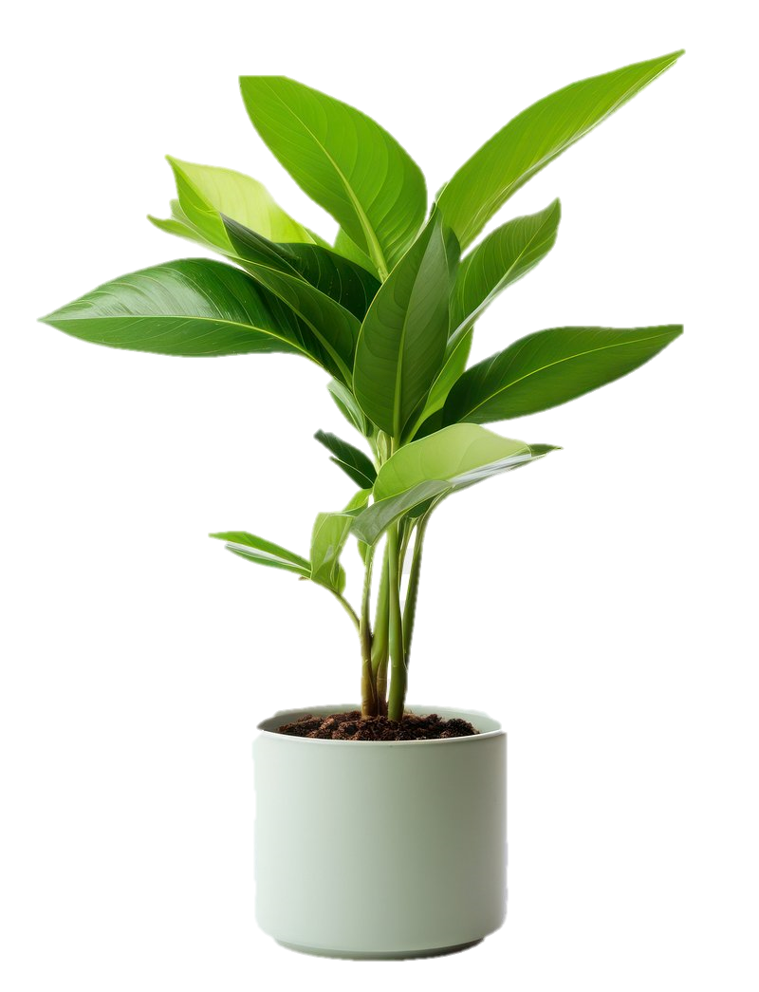

Slide 21
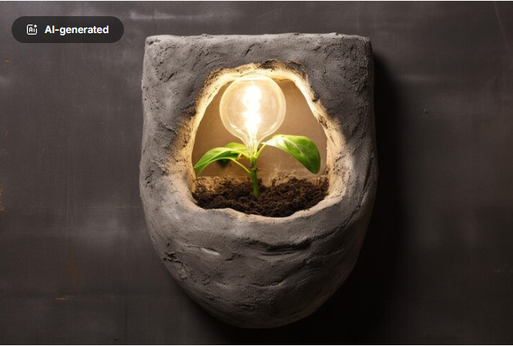

Slide 22


Slide 23
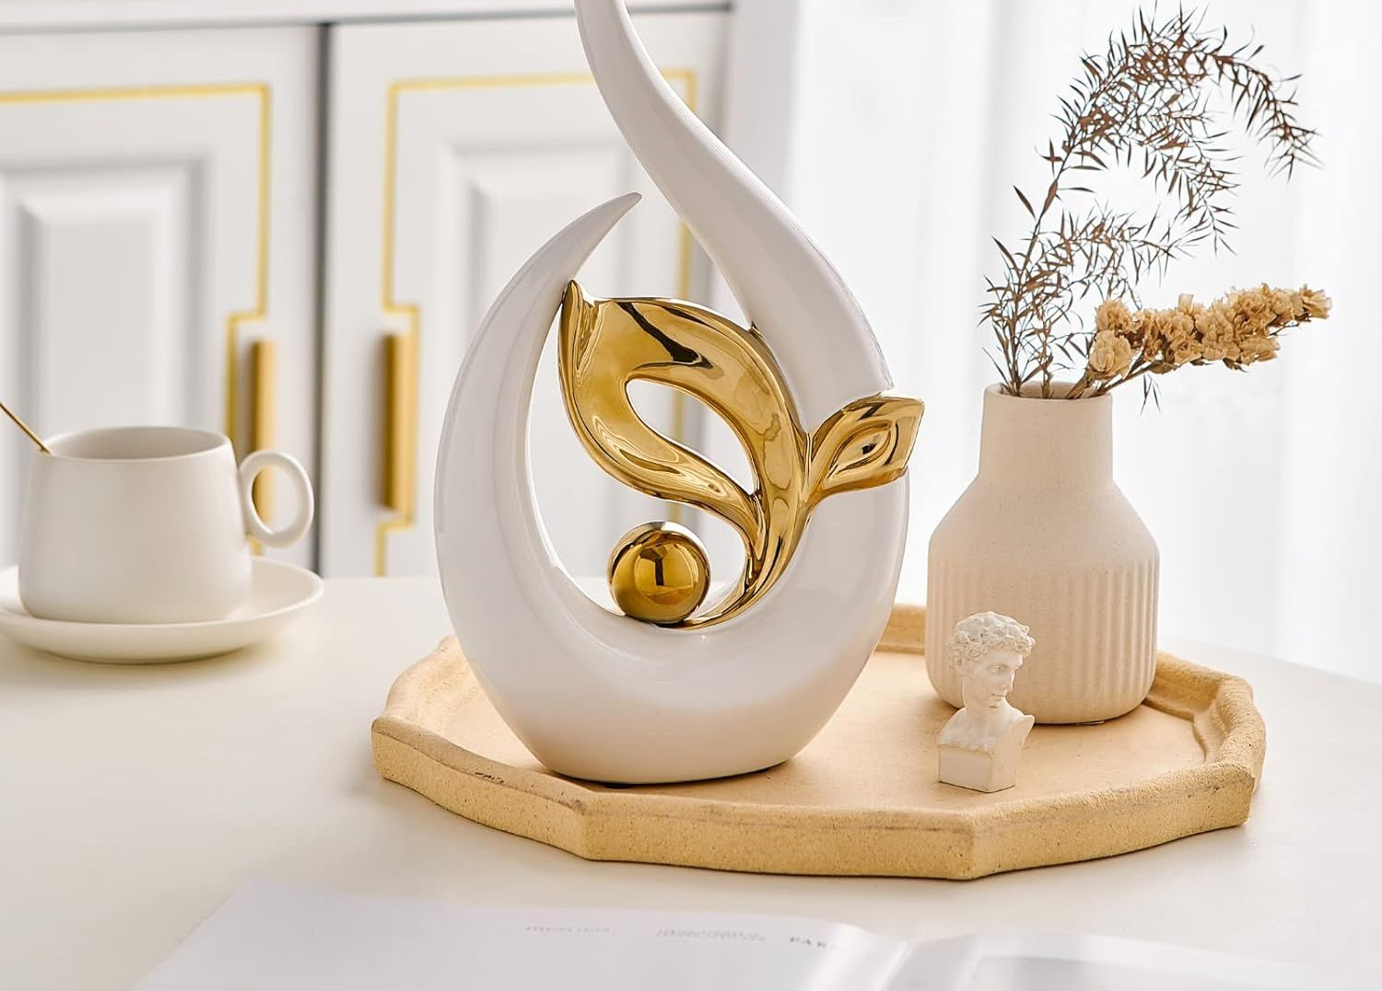

Slide 24
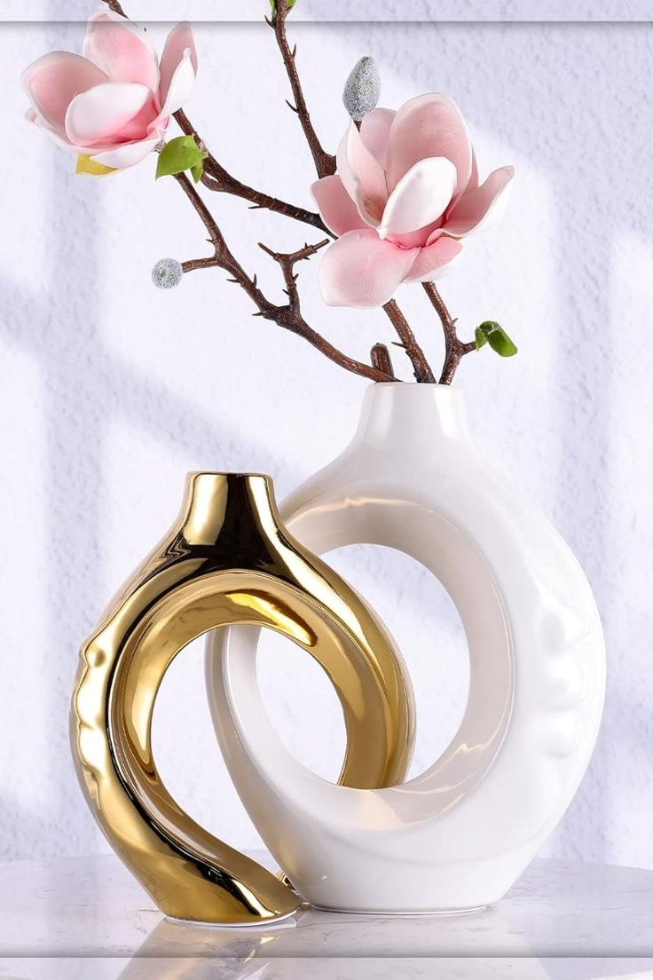

Slide 25


Slide 26
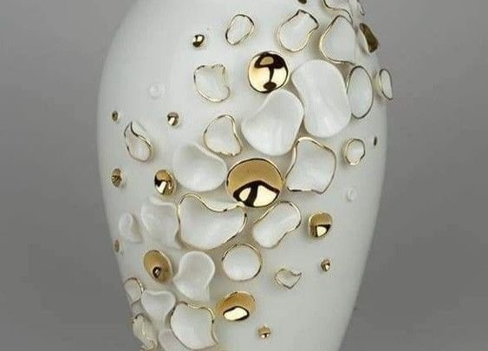

Slide 27
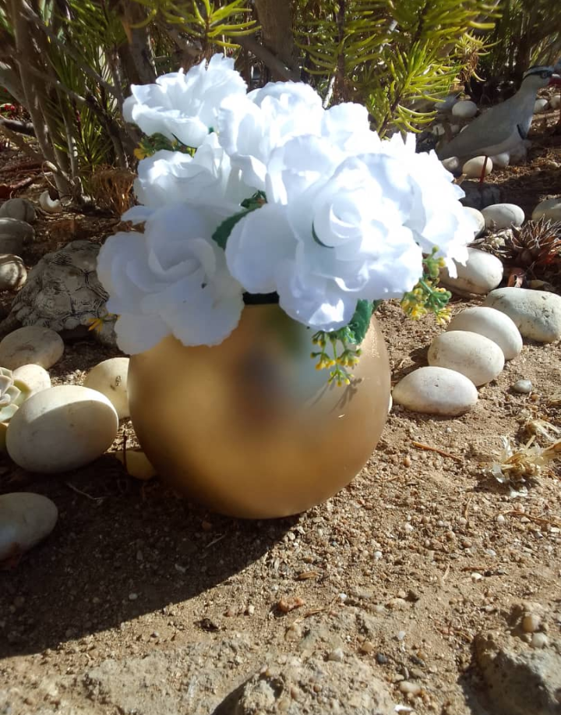

Slide 28
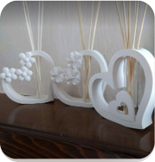

Slide 31
